Slide 1
Chapter-2
First Order Equations

Slide 2
Section-7
Homogeneous Equations

Slide 3
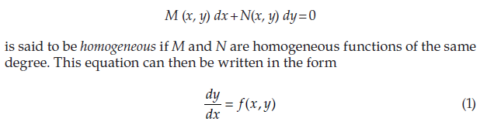
Homogeneous Equations

Slide 5


Slide 6
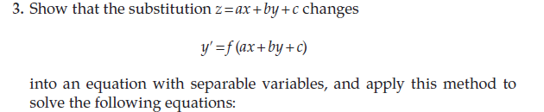

Slide 8
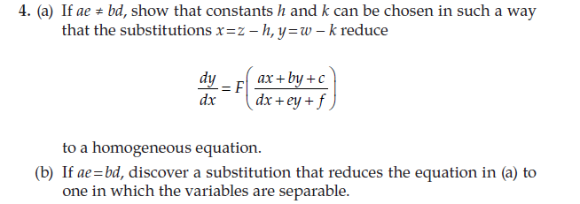

Slide 9
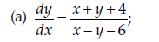

Slide 11
Lecture on 12/9/22

Slide 12
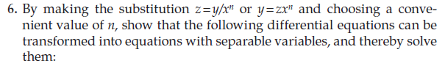
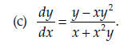

Slide 14
Section 8
Exact Equations

Slide 15
A DE is said to be exact if it can be derived from its general solution directly by differentiation without any subsequent multiplication, elimination etc.
i.e M(x,y) dx +N(x,y) dy =0 is exact if there exists f(x,y) such that
M dx+N dy= df

Slide 16
Exercise : pg 53,54

Slide 17
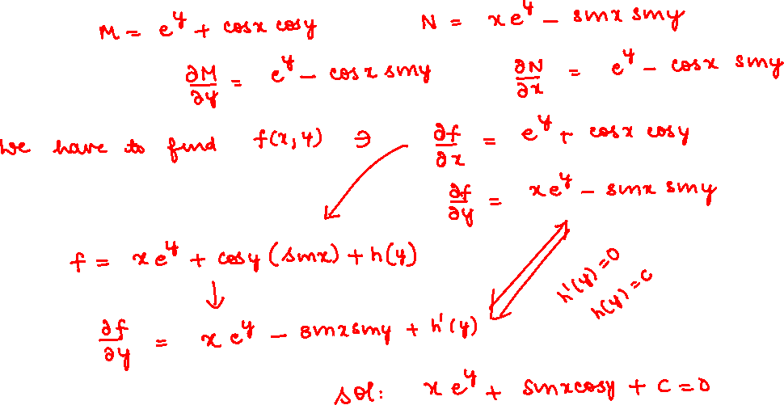

Slide 20
Section-9
Integrating Factors

Slide 23
Lecture on 14/9/22

Slide 24
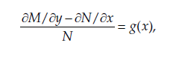
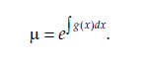
Rule-1

Slide 25
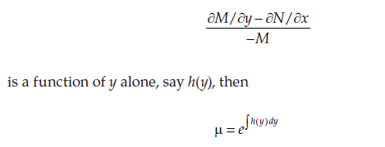
Rule-2

Slide 26
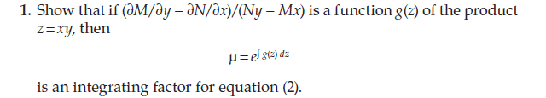
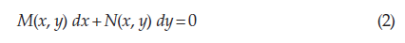
Exercise pg 59,60

Slide 28
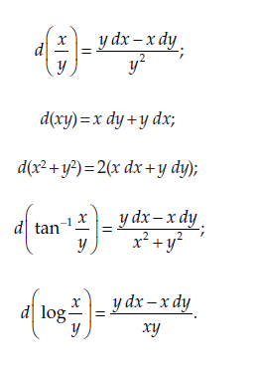

Slide 29
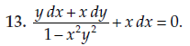

Slide 30
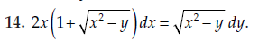

Slide 32


Slide 36
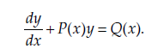
Section-10
Linear Equations

Slide 37
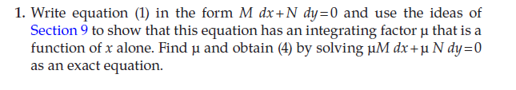

Slide 39
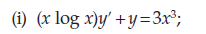

Slide 40
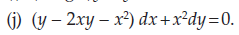

Slide 44
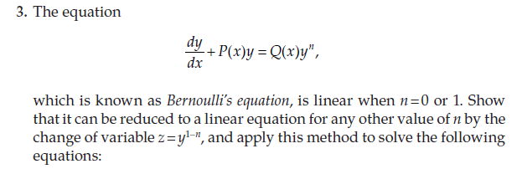

Slide 50
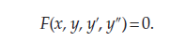
Section11
Reduction of Order

Slide 51
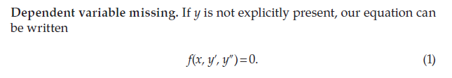

Slide 52
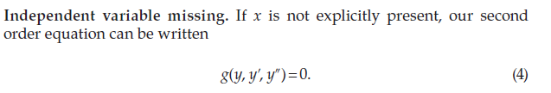

Slide 55
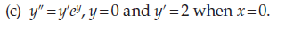

Slide 57
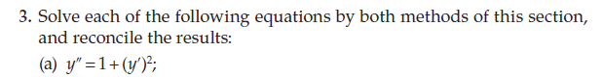

Slide 59
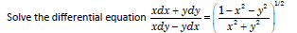
Practice Problems
Show that the family of parabolas y²= 4cx+4c² is self-orthogonal

Slide 60
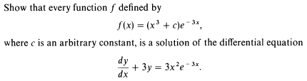
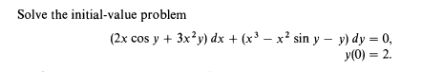
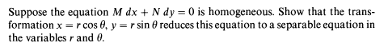

Slide 61
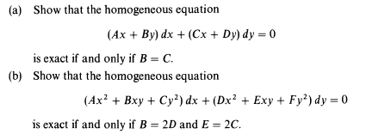
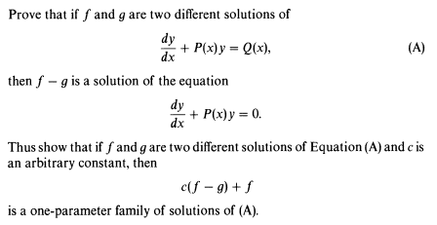

Slide 62
Solve ( y(1-x tanx)+x² cosx)dx-xdy=0

Slide 63
Justify that a differential equation of the form
is not exact.
Show that is an integrating factor and hence solve the
Equation for

Slide 64
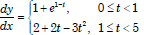
A continuous function y(t) satisfies the differential equation
If

Slide 65
Chapter-3
Second Order Linear Equations

Slide 67
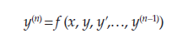
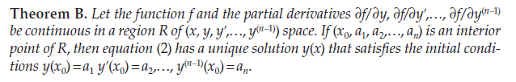
Existence and Uniqueness of Solutions

Slide 69
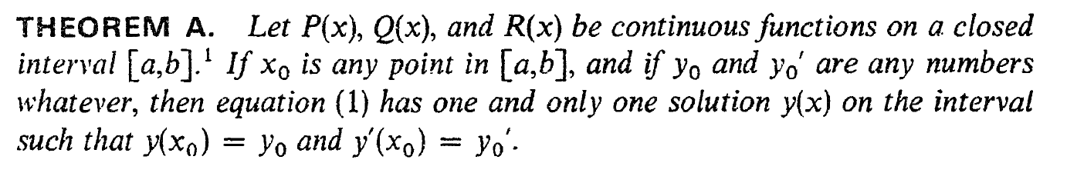
Section - 14

